Slide 1




Data Structures & Algorithms
Part # 6:
Linked Lists
Dr. Ali Al-Ibrahim

Slide 2

Towards Dynamic Data Structures
Array is a collection of homogeneous elements which are stored at consecutive locations
Main limitations of arrays:
  It is a static data structure
  Its size must be known at compilation time, in most programming languages
  Inefficient insertion and deletion of elements
A dynamic data structure can overcome these problems

Slide 3
Quiz
What is a Linked List?
Linked lists offer an efficient use of memory, Why ??
Dr. Ali Al-Ibrahim / WISE / IT

Slide 4

What is a Dynamic Data Structure?
A data structure that can shrink or grow during program execution
The size of a dynamic data structure is not necessarily known at compilation time, in most programming languages
Efficient insertion and deletion of elements
The data in a dynamic data structure can be stored in non-contiguous (arbitrary) locations
Linked list is an example of a dynamic data structure

Slide 5

What is a Linked List?
A linked list is a collection of nodes, each node holding some information and a pointer to another node in the list
In the following example, there are four nodes, which are not stored at consecutive locations
300
100
400
40
!
80
25
600
30
Information part
Pointer (Address part)

Slide 6
Advantages of linked list
Unused locations in array is often a wastage of space
Linked lists offer an efficient use of memory
  Create nodes when they are required
  Delete nodes when they are not required anymore
  We don’t have to know in advance how long the list should be

Slide 7

Singly Linked Lists
In the previous sections, we presented the array data structure and discussed some of its applications.
Arrays are nice and simple for storing things in a certain order.
But they have the drawback of not being very adaptable, since we have to fix the size N of the array in advance.
A linked list:
  is a collection of nodes that together form a linear ordering.
  The ordering is determined as in the children's
  game "Follow the Leader," in that each node
  is an object that stores a reference to
  an element and a reference, called next,
  to another node.
Dr. Ali Al-Ibrahim / WISE / IT

Slide 8
Singly Linked Lists
A singly linked list is a concrete data structure consisting of a sequence of nodes
Each node stores
  element
  link to the next node
next
elem
node
∅
A
B
C
D
Dr. Ali Al-Ibrahim / WISE / IT

Slide 9

Singly Linked Lists
Figure 3.10: Example of a singly linked list whose elements are strings indicating airport codes. The next pointers of each node are shown as arrows. The null object is denoted as ∅.
Dr. Ali Al-Ibrahim / WISE / IT

Slide 10
Singly Linked Lists
A node reference another node, the next reference inside a node is a link or pointer to another node.
Moving from one node to another by following a next reference is known as link hopping or pointer hopping.
The first and last node of a linked list usually are called the head and tail of the list, respectively.
Thus, we can link hop through the list starting at the head and ending at the tail.
We can identify the tail as the node having a null next reference, which indicates the end of the list.
A linked list defined in this way is known as a singly linked list.
Dr. Ali Al-Ibrahim / WISE / IT

Slide 11
Singly Linked Lists
Like an array,
  a singly linked list keeps its elements in a certain order.
  This order is determined by the chain of next links going from each node to its successor in the list.
Unlike an array,
  a singly linked list does not have a predetermined fixed size,
  and uses space proportional to the number of its elements.
  Likewise, we do not keep track of any index numbers for the nodes in a linked list.
  So we cannot tell just by examining a node if it is the second, fifth, or twentieth node in the list.
Dr. Ali Al-Ibrahim / WISE / IT

Slide 12
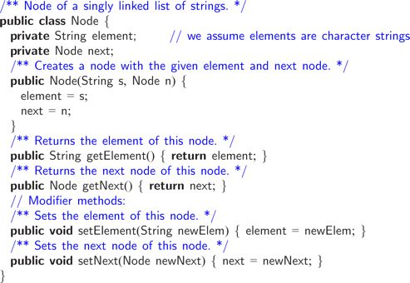
Implementing a Singly Linked List
To implement a singly linked list, we define a Node class, which specifies the type of objects stored at the nodes of the list. Here we assume elements are character strings.
Dr. Ali Al-Ibrahim / WISE / IT

Slide 13
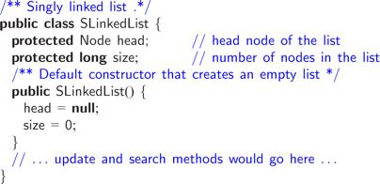
Implementing a Singly Linked List
Given the Node class, we can define a class, SLinkedList, defining the actual linked list. This class keeps a reference to the head node and a variable counting the total number of nodes.
Dr. Ali Al-Ibrahim / WISE / IT

Slide 14
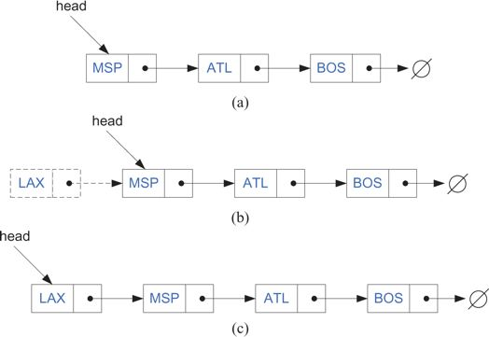
Insertion in a Singly Linked List
When using a singly linked list, we can easily insert an element at the head of the list.
The main idea is:
  create a new node,
  set its next link to refer to the same object as head,
  and then set head to point to the new node.
Dr. Ali Al-Ibrahim / WISE / IT

Slide 15

Insertion in a Singly Linked List
Code Fragment 3.14: Inserting a new node v at the beginning of a singly linked list. Note that this method works even if the list is empty. Note that we set the next pointer for the new node v before we make variable head point to v.
Dr. Ali Al-Ibrahim / WISE / IT

Slide 16
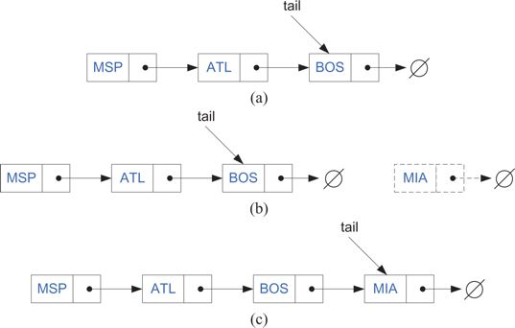
Inserting an Element at the Tail of a Singly Linked List
We can also easily insert an element at the tail of the list, provided we keep a reference to the tail node, as shown in Figure 3.12.
In this case,
  we create a new node,
  assign its next reference to point to the null object,
  set the next reference of the tail to point to this new object,
  and then assign the tail reference itself to this new node.
Dr. Ali Al-Ibrahim / WISE / IT

Slide 17
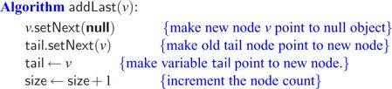
Inserting an Element at the Tail of a Singly Linked List
Code Fragment 3.15: Inserting a new node at the end of a singly linked list. This method works also if the list is empty. Note that we set the next pointer for the old tail node before we make variable tail point to the new node.
Dr. Ali Al-Ibrahim / WISE / IT

Slide 18
Quiz’ (one possible) solution
add_element(head, v){ // head is the head of sorted_list, v is the value to be added
Node p, q, ptr; // we assume that the Node class exist
ptr = new Node(v, null);
if (v >= head.getElement()){
ptr.setNext(head);
head = ptr;
size++;
}
else{
p = head;
q.setNext(head.getNext());
while (v <= q.getElement() && q.getNext() != null){
p.setNext(q.getNext());
q.setNext(q.getNext());
} //end while
p.setNext(ptr);
ptr.setNext(q);
size++;
}// end else
}// end method
Dr. Ali Al-Ibrahim / WISE / IT

Slide 19
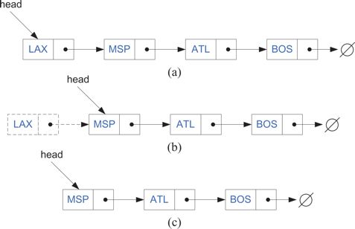
Removing an Element in a Singly Linked List
The reverse operation of inserting a new element at the head of a linked list is to remove an element at the head.
Figure 3.13: Removal of an element at the head of a singly linked list:
(a) before the removal;
(b) "linking out" the old new node;
(c) after the removal.
Dr. Ali Al-Ibrahim / WISE / IT

Slide 20
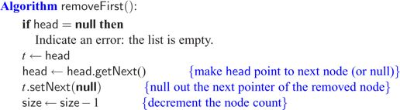
Removing an Element in a Singly Linked List
Code Fragment 3.16: Removing the node at the beginning of a singly linked list.
Dr. Ali Al-Ibrahim / WISE / IT

Slide 21
Removing an Element in a Singly Linked List
Unfortunately, we cannot easily delete the tail node of a singly linked list. Even if we have a tail reference directly to the last node of the list,
  we must be able to access the node before the last node in order to remove the last node.
  But we cannot reach the node before the tail by following next links from the tail.
  The only way to access this node is to start from the head of the list and search all the way through the list.
  But such a sequence of link hopping operations could take a long time.
Dr. Ali Al-Ibrahim / WISE / IT

Slide 22
Doubly Linked Lists
As we saw in the previous section, removing an element at the tail of a singly linked list is not easy.
Indeed, it is time consuming to remove any node other than the head in a singly linked list, since we do not have a quick way of accessing the node in front of the one we want to remove.
Indeed, there are many applications where we do not have quick access to such a predecessor node.
For such applications, it would be nice to have a way of going both directions in a linked list.
There is a type of linked list that allows us to go in both directions
  —forward
  and reverse—in a linked list.
It is the doubly linked list.
Such lists allow for
  a great variety of quick update operations, including insertion and removal at both ends, and in the middle.
A node in a doubly linked list stores two references
  a next link, which points to the next node in the list,
  and a prev link, which points to the previous node in the list.
Dr. Ali Al-Ibrahim / WISE / IT

Slide 23
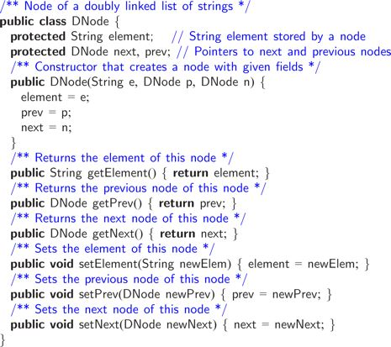
Doubly Linked Lists
Dr. Ali Al-Ibrahim / WISE / IT

Slide 24
Doubly Linked Lists
Header and Trailer Sentinels حارس
To simplify programming,
  it is convenientملائم to add special nodes at both ends of a doubly linked list:
    a header node just before the head of the list,
    and a trailer node just after the tail of the list.
    These "dummy" تمثيل, وهمي or sentinel nodes do not store any elements.
    The header has a valid next reference but a null prev reference,
    while the trailer has a valid prev reference but a null next reference.
  A doubly linked list with these sentinels is shown in Figure 3.14. Note that a linked list object would simply need to store references to these two sentinels and a size counter that keeps track of the number of elements (not counting sentinels) in the list.
Dr. Ali Al-Ibrahim / WISE / IT

Slide 25

Doubly Linked Lists
Figure 3.14: A doubly linked list with sentinels, header and trailer, marking the ends of the list. An empty list would have these sentinels pointing to each other. We do not show the null prev pointer for the header nor do we show the null next pointer for the trailer.
Dr. Ali Al-Ibrahim / WISE / IT

Slide 26
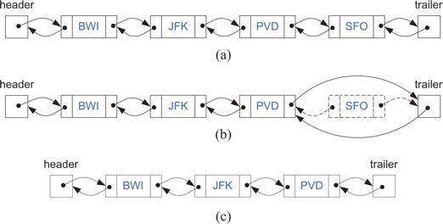
Doubly Linked Lists
Inserting or removing elements at either end of a doubly linked list is straight- forward to do.
Indeed, the prev links eliminate the need to traverse the list to get to the node just before the tail.
Figure 3.15: Removing the node at the end of a a doubly linked list with header and trailer sentinels: (a) before deleting at the tail; (b) deleting at the tail; (c) after the deletion.
Dr. Ali Al-Ibrahim / WISE / IT

Slide 27
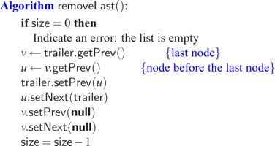
Doubly Linked Lists
Code Fragment 3.18:Removing the last node of a doubly linked list. Variable size keeps track of the current number of elements in the list. Note that this method works also if the list has size one.
Dr. Ali Al-Ibrahim / WISE / IT

Slide 28
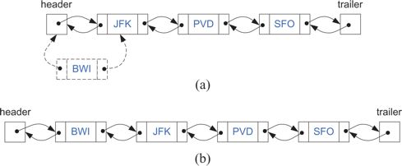
Doubly Linked Lists
Likewise, we can easily perform an insertion of a new element at the beginning of a doubly linked list.
Figure 3.16: Adding an element at the front: (a) during; (b) after.
Dr. Ali Al-Ibrahim / WISE / IT

Slide 29
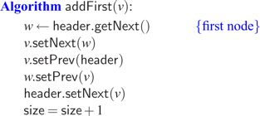
Doubly Linked Lists
Code Fragment 3.19:Inserting a new node v at the beginning of a doubly linked list. Variable size keeps track of the current number of elements in the list. Note that this method works also on an empty list.
Dr. Ali Al-Ibrahim / WISE / IT

Slide 30
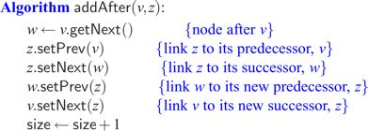
Insertion in the Middle of a Doubly Linked List
Given a node v of a doubly linked list (which could be possibly the header but not the trailer), we can easily insert a new node z immediately after v. Specifically, let w the node following v. We execute the following steps:
1. make z's prev link refer to v
2. make z's next link refer to w
3. make w's prev link refer to z
make v's next link refer to z
Code Fragment 3.20: Inserting a new node z after a given node v in a doubly linked list.
Dr. Ali Al-Ibrahim / WISE / IT

Slide 31
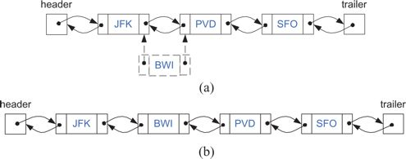
Insertion in the Middle of a Doubly Linked List
Figure 3.17: Adding a new node after the node storing JFK: (a) creating a new node with element BWI and linking it in; (b) after the insertion.
Dr. Ali Al-Ibrahim / WISE / IT

Slide 32
Removal in the Middle of a Doubly Linked List
It is easy to remove a node v in the middle of a doubly linked list.
We access the nodes u and w on either side of v using v's getPrev and getNext methods (these nodes must exist, since we are using sentinels).
To remove node v, we simply have u and w point to each other instead of to v. We refer to this operation as the linking out of v.
We also null out v's prev and next pointers so as not to retain old references into the list.
Dr. Ali Al-Ibrahim / WISE / IT

Slide 33
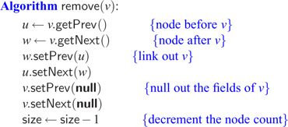
Removal in the Middle of a Doubly Linked List
Code Fragment 3.21: Removing a node v in a doubly linked list. This method works even if v is the first, last, or only nonsentinel node.
Dr. Ali Al-Ibrahim / WISE / IT

Slide 34
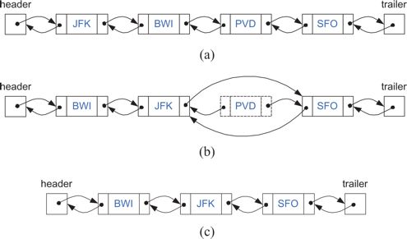
Removal in the Middle of a Doubly Linked List
Figure 3.18: Removing the node storing PVD: (a) before the removal; (b) linking out the old node; (c) after the removal (and garbage collection).
Dr. Ali Al-Ibrahim / WISE / IT

Slide 35
Circularly Linked Lists
A circularly linked list has the same kind of nodes as a singly linked list.
Each node in a circularly linked list has a next pointer and a reference to an element.
But there is no head or tail in a circularly linked list.
For instead of having the last node's next pointer be null,
  in a circularly linked list, it points back to the first node.
  Thus, there is no first or last node.
  If we traverse the nodes of a circularly linked list from any node by following next pointers, we will cycle through the nodes.
Even though a circularly linked list has no beginning or end,
  but we need some node to be marked as a special node, which we call the cursor.
    The cursor node= starting point allows us to have a place to start from if we ever need to traverse a circularly linked list.
    And if we remember this starting point, then we can also know when we are done-we are done with a traversal of a circularly linked list when we return to the node that was the cursor node when we started.
Dr. Ali Al-Ibrahim / WISE / IT

Slide 36
Circularly Linked Lists
By using cursor node, we can then define some simple update methods for a circularly linked list:
add(v): Insert a new node v immediately after the cursor; if the list is empty, then v becomes the cursor and its next pointer points to itself.
remove(v): Remove and return the node v immediately after the cursor (not the cursor itself, unless it is the only node); if the list becomes empty, the cursor is set to null.
advance(v): Advance the cursor to the next node in the list.
Dr. Ali Al-Ibrahim / WISE / IT

Slide 37
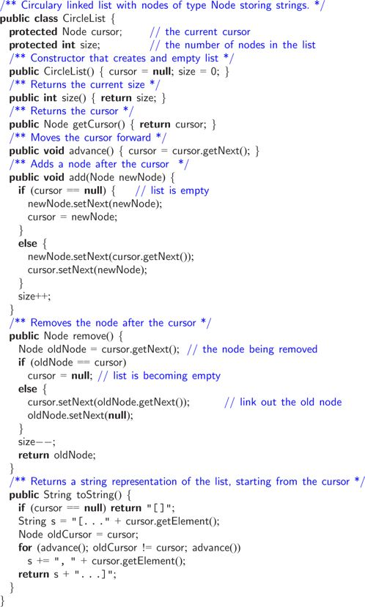
Circularly Linked Lists
Code Fragment 3.25: A circularly linked list class with simple nodes
Dr. Ali Al-Ibrahim / WISE / IT

Slide 38
Circularly Linked Lists
Some Observations about the CircleList Class
There are a few observations we can make about the CircleList class.
It is a simple program that can provide enough functionality to simulate circle games, like Duck, Duck, Goose. I
it is not a robust قوي program, however. In particular, if a circle list is empty, then calling advance or remove on that list will cause an exception. (Which one?) Exercise R-3.5 deals with this exception-generating behavior and ways of handling this empty-list condition better.
Explain what has been done to solve this exception?
Sorting a Linked List
Write the algorithm “Code Fragment 3.27” in JAVA and shows the the circularly linked list items before sorting and after sorting.
Dr. Ali Al-Ibrahim / WISE / IT

